Slide 1

- Pertemuan 7 -
Web Development Framework
- Pengembangan Berbasis Platform -

Slide 2
Framework and Libraries
Libraries and frameworks are sets of pre-written code.
Libraries are smaller & are used for specific cases.
A framework contains tools and components that allow the developers to write code faster.
Also many frameworks contain libraries.
As a beginner level developer, it is not suggested that you begin with or indulge yourself with frameworks and libraries as it may make things complicated.
When you are confident enough you may want to try your hand in building websites using frameworks.

Slide 3
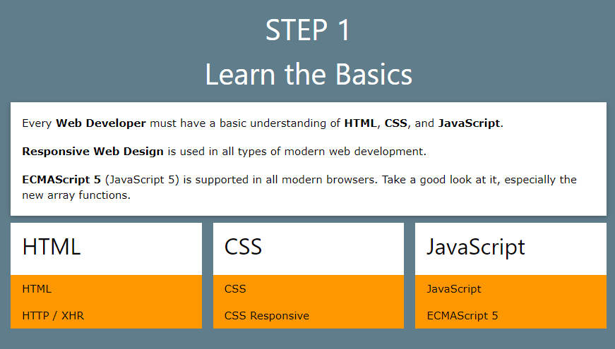
Front-End Roadmap

Slide 4
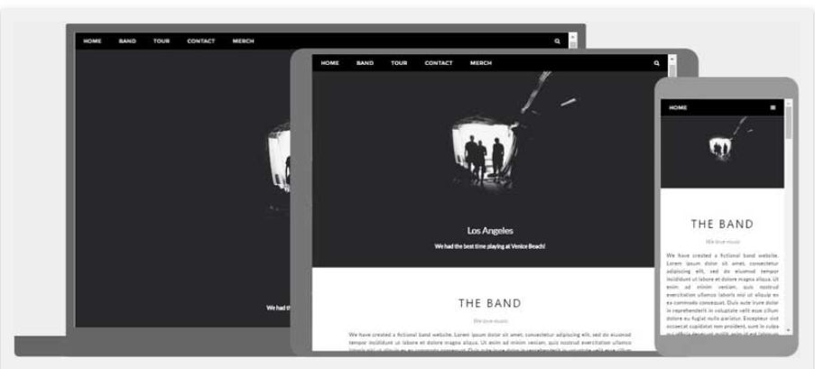
Responsive Web Design

Slide 5
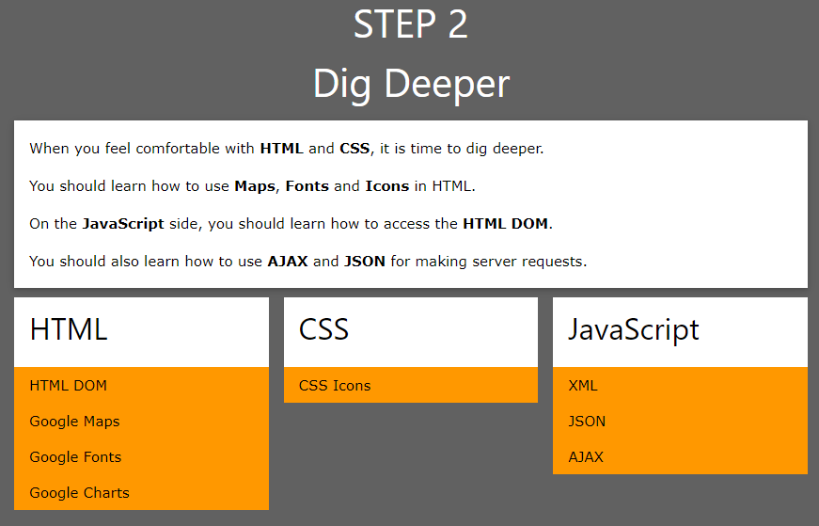
Front-End Roadmap

Slide 6
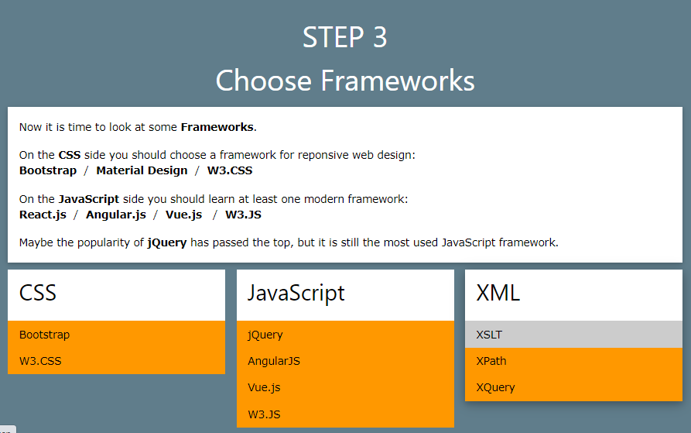
Front-End Roadmap

Slide 7
Front-End Javascript Framework
React JS
React is a JavaScript library for building user interfaces.
React is used to build single page applications.
React allows us to create reusable UI components.
It was developed and maintained by Facebook, and Facebook and Instagram use it.

Slide 8
Front-End Javascript Framework (2)
AngularJS
AngularJS extends HTML with new attributes.
AngularJS is perfect for Single Page Applications (SPAs).
Google developed angular, and Google, Microsoft, and Paypal use it.
Vue.js
It is a progressive framework for building user interfaces.
Vue is also perfectly capable of powering sophisticated Single-Page Applications when used in combination with modern tooling and supporting libraries.

Slide 9
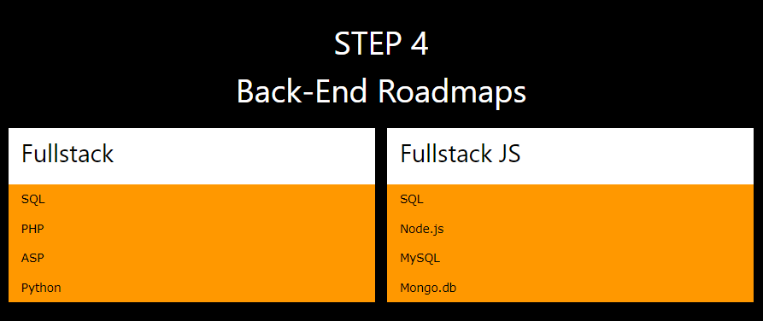
Back-End Roadmap

Slide 10
Back-End Web Development Framework
PHP
Laravel
Symfony
Python
Django
Flask
Java
Spring
Web2Py
CodeIgniter
Zend

Slide 11
References
https://www.w3schools.com/whatis/
https://hackr.io/blog/top-10-web-development-frameworks-in-2020

